Slide 1
IoMT (Internet Of Military Things)

Slide 2
Applications of IoMT :-
Internet of Military Things (IoMT) or Internet of Battlefield Things (IoBT) is a class of Internet of Things for modern battle operations and intelligent warfare.
It refers to the physical components in the Military domain, Embedded with sensors and monitors to track the ongoing processes.
These sensors collect information like Biometrics, Live location, Capture images and process the data etc.

Slide 3
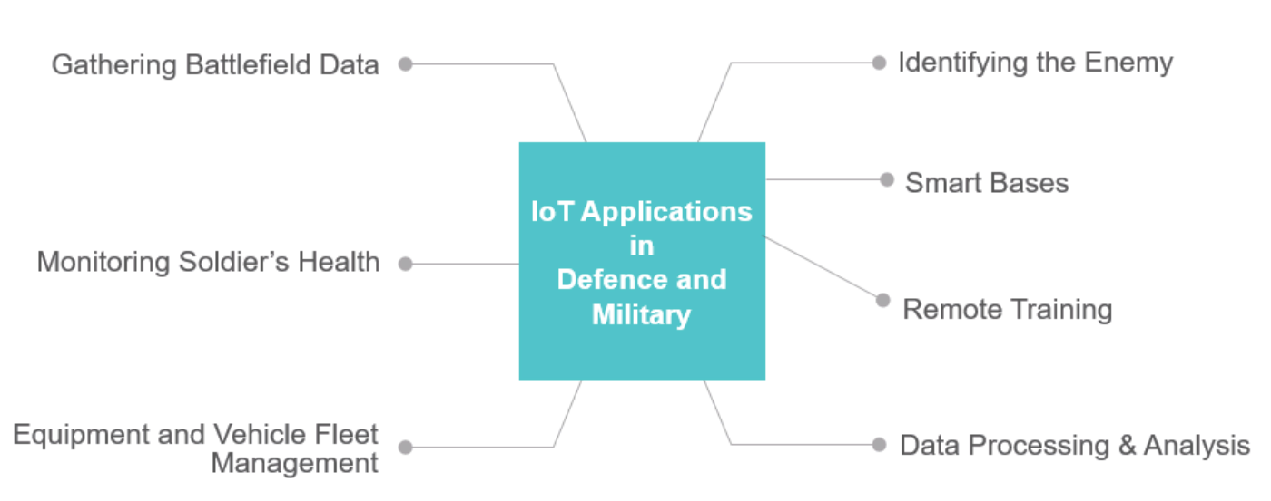
Flow Chart :-

Slide 4
Main objective :-
The Main objective of our project is to showcase the upcoming developments in the smart base and battlefield communication.
This involves the basic tracking of ongoing data both on the military base and the battle fields simultaneously.
This data is collected from different segments and branches. Based on the collected information an alert message is sent incase of any emergency.

Slide 5

Monitoring Health :-
Another application of IoT in defence and the military is knowing the health status of a soldier. This is done by using smart wearables which track or centrally monitor their physical health and mental health. Sensors can monitor heart rate, body temperature, and thermal distribution as well as some behavioral attributes like speech patterns. The data about their changing medical condition can be shared with doctors in real-time so that they can arrange medical supplements or equipment in advance based on their needs.

Slide 6

Data Processing & Analysis
The information collected by IoT about various defence and military areas, such as weapons, aircraft, fleet, and troops can increase the effectiveness of their intelligence, surveillance, and reconnaissance systems. The data obtained related to these areas can enable armed forces to identify key threats quickly and with more accuracy. Military personnel can perform analysis on the collected data to recognize patterns and derive correlations.

Slide 7
Morse code generation and implementation :-
There are different methods by which the communications happens among the troops and base camps. One such method which is most suitable in an crucial situation is the generation of Morse codes.
Though it is an old process, this gives a better hand when it comes to communication under pressurized situation.
These codes can be generated through dots and dashes and can be embedded onto an wearable device which a soldier or any person for that matter on a battlefield can wear.
To study this technology we have implemented this on a small 4x4 matrix layout keypad .

Slide 8
The 4x4 matrix layout keypad creates an interface to communicate among the smart bases.
These smart bases are military bases which are fully connected via Iot to monitor the environment in an efficient way.
The keypad is coded in such a way that when the keys are mapped and triggered, it generates a pulse which then is amplified and transmitted over the wide spread network of bases.
These pulses are branch specific, that means the specific set of pulse is generated to alert the specific branch of the Military base network.

Slide 9
Important Applications:-
Medical Assistance incase of an emergency.
Supply Chain Management.
Requesting for the extra supply of reinforcements during battle.
Uninterrupted Communication among the base camps and troops.
Equipment and vehicle fleet management.

Slide 10
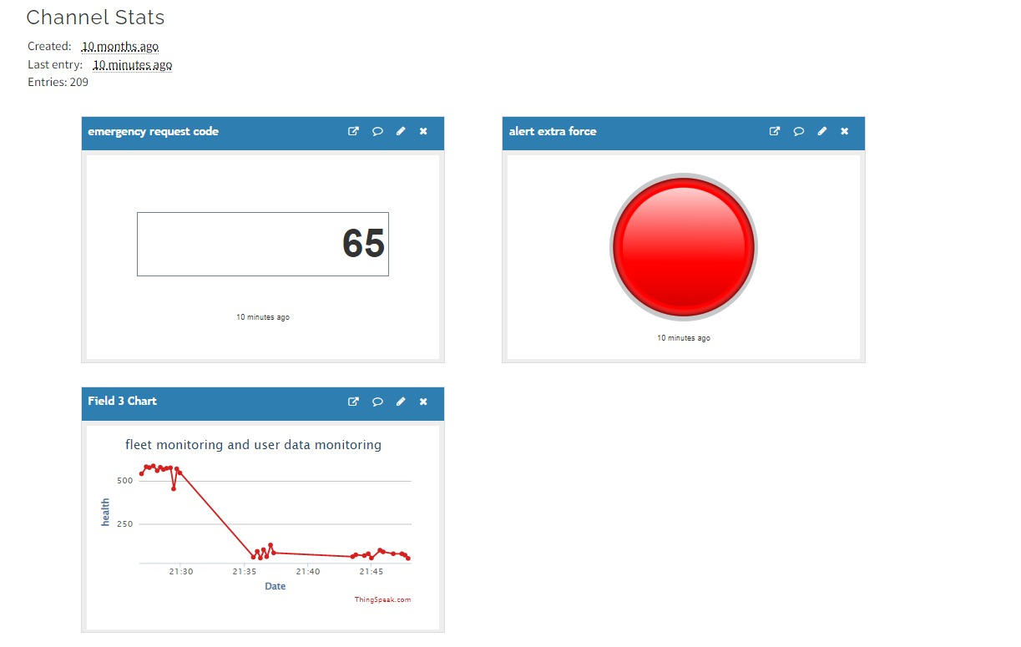
Simulations & Graphs :-

Slide 11
Conclusion :-
With the increasing anti-military activities, the use of IoT in the military and defence has become a necessity. Integrating IoT into existing military and defence infrastructures can help them become more efficient and effective and can significantly reduce combat losses in lives and equipment. Incorporating IoT into any kind of operation such as battlefield combat, spying an enemy base, or search and rescue. Combining IoT with Machine Learning can further help the military and defence in getting critical insights into the battlefield in real-time, enabling them to carry out a successful operation.

